Slide 1


E-Commerce Website System
cloning Amazon Clone using Spring Boot
Made by Asrar Fallatah

Slide 2

Extra End Points
Sort products from cheap to expensive or expensive to cheap by category name.
See products by category name
Add balance to a user
View only in-stock products
Search for a product by name and see all his information .
calculate how much a merchant earned
Get user history purchase by id .
Check in buy method if the user is admin if yes deny him and prevent from doing anything .

Slide 3
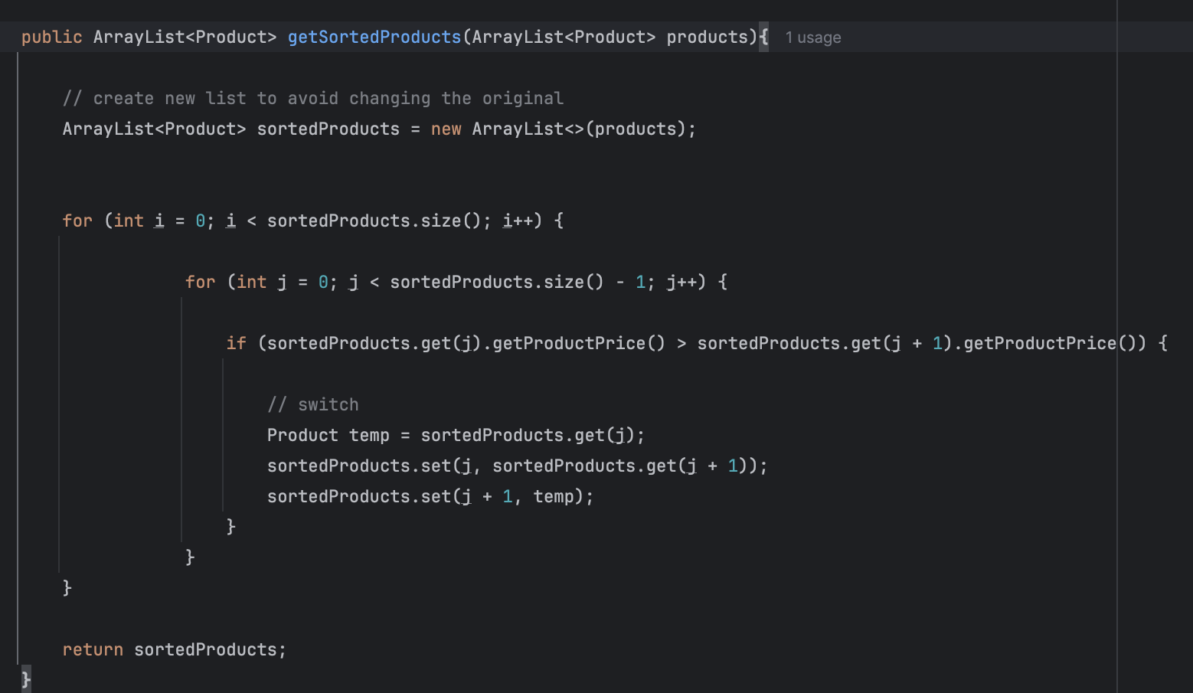
Sort product from cheap to expensive

Slide 4
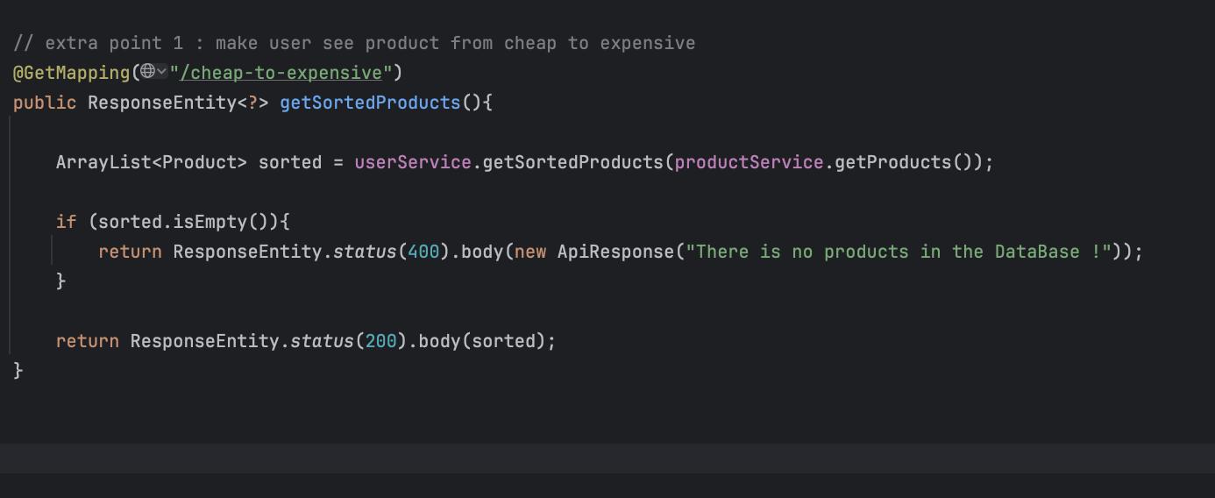
Sort product from cheap to expensive

Slide 5
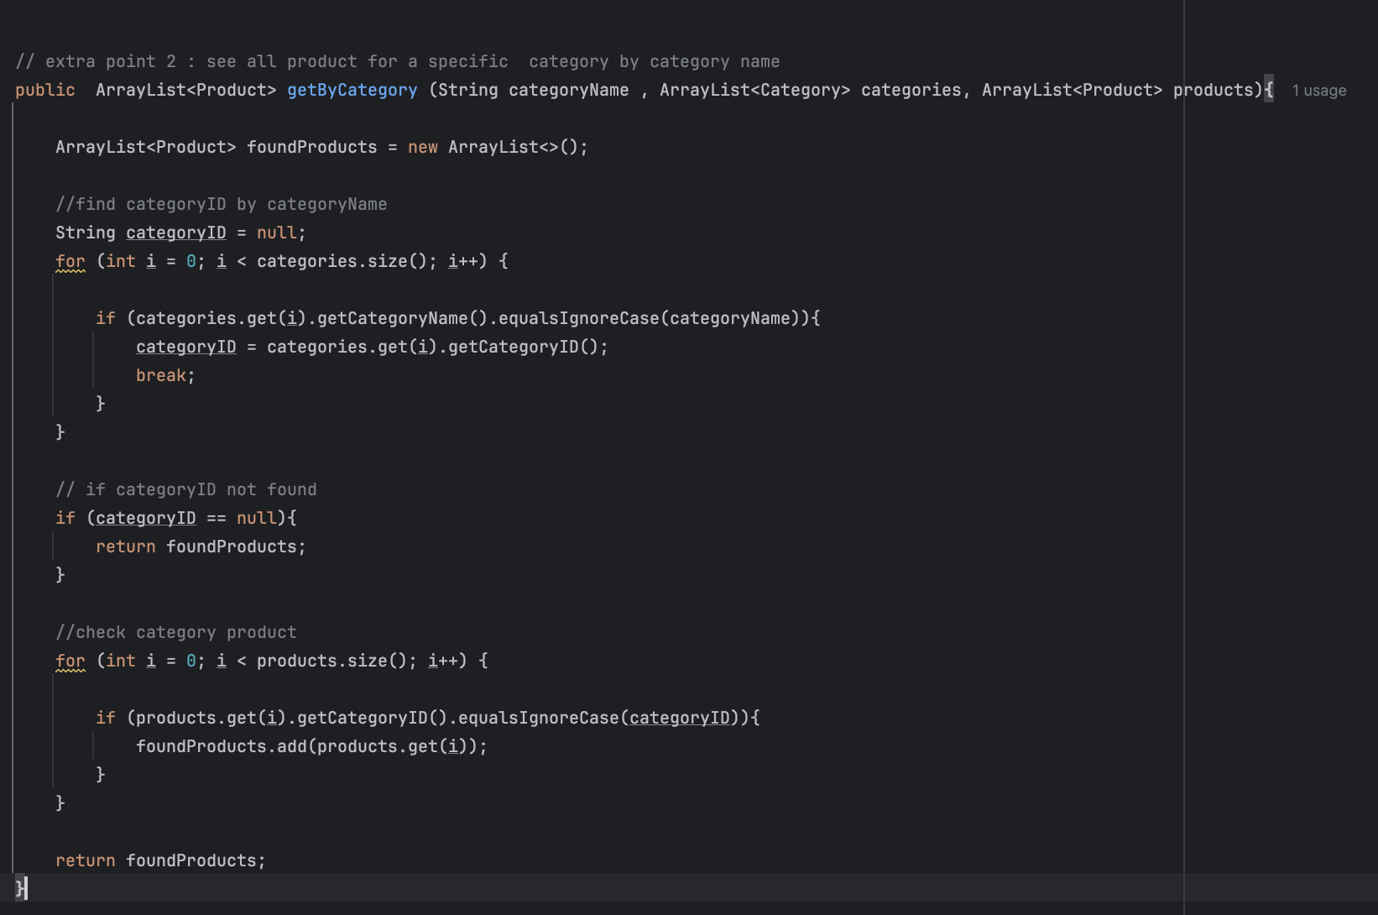
See products by category name

Slide 6
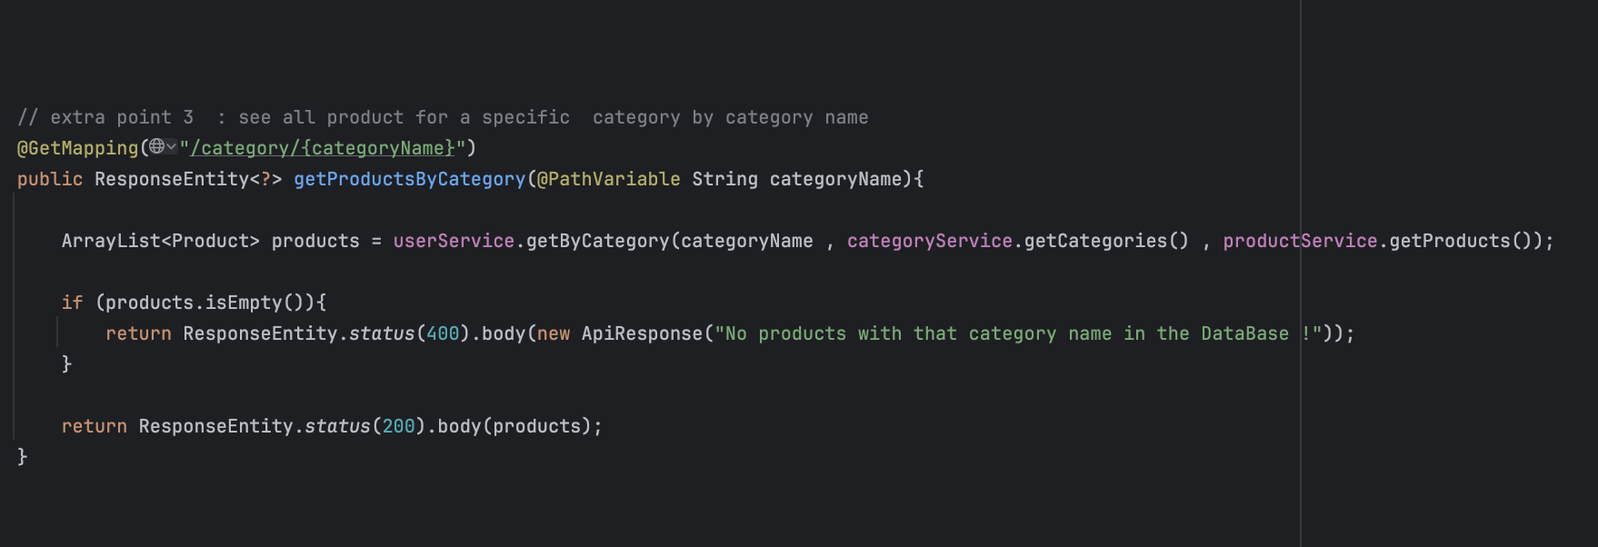
See products by category name

Slide 7
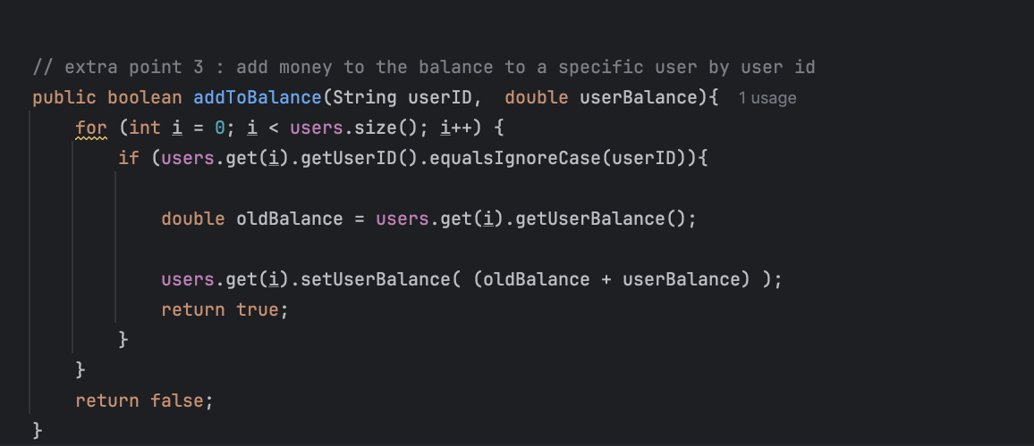
Add balance to a user

Slide 8
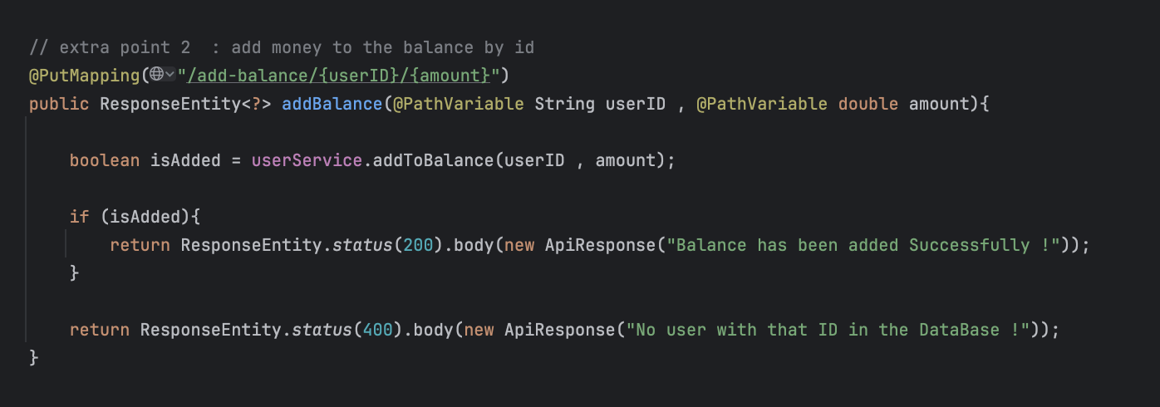
Add balance to a user

Slide 9
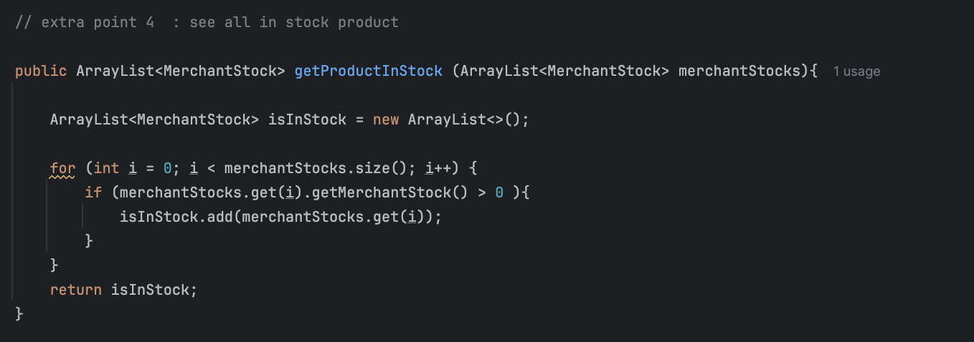
View only in-stock products

Slide 10
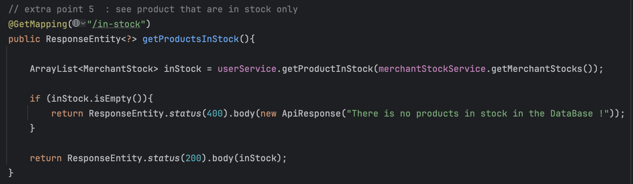
View only in-stock products

Slide 11
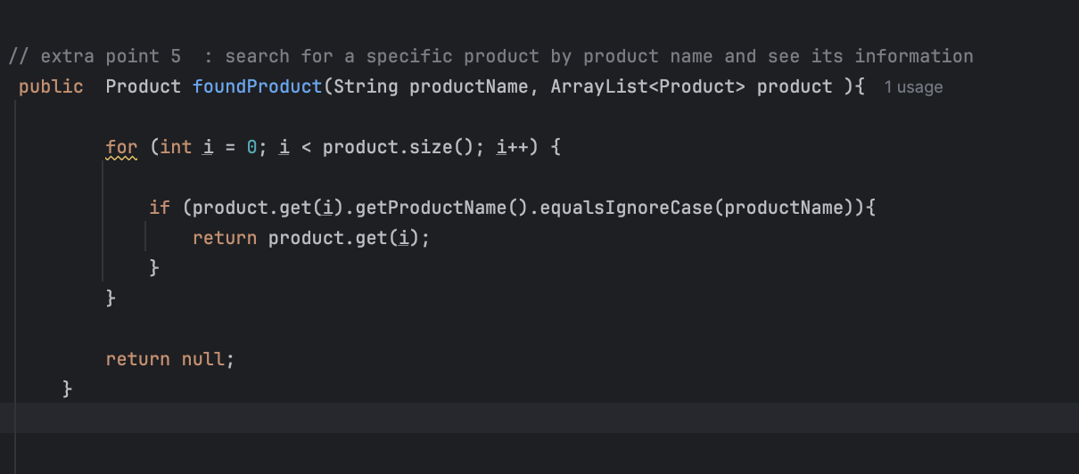
Search for a product by name

Slide 12
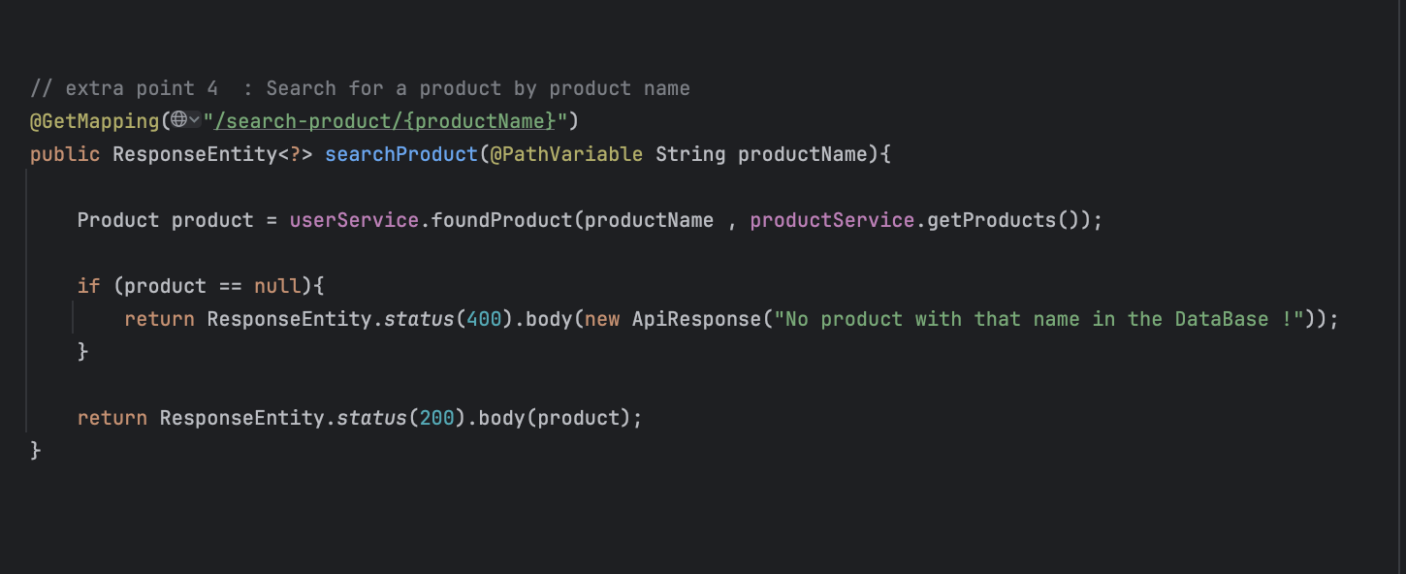
Search for a product by name

Slide 13
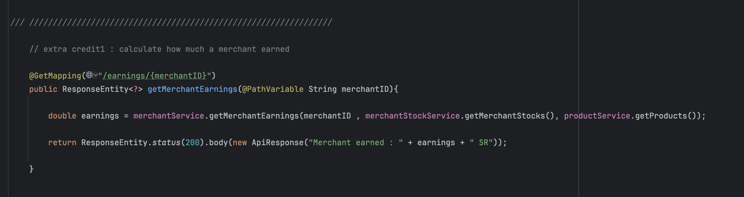
calculate how much a merchant earned

Slide 14
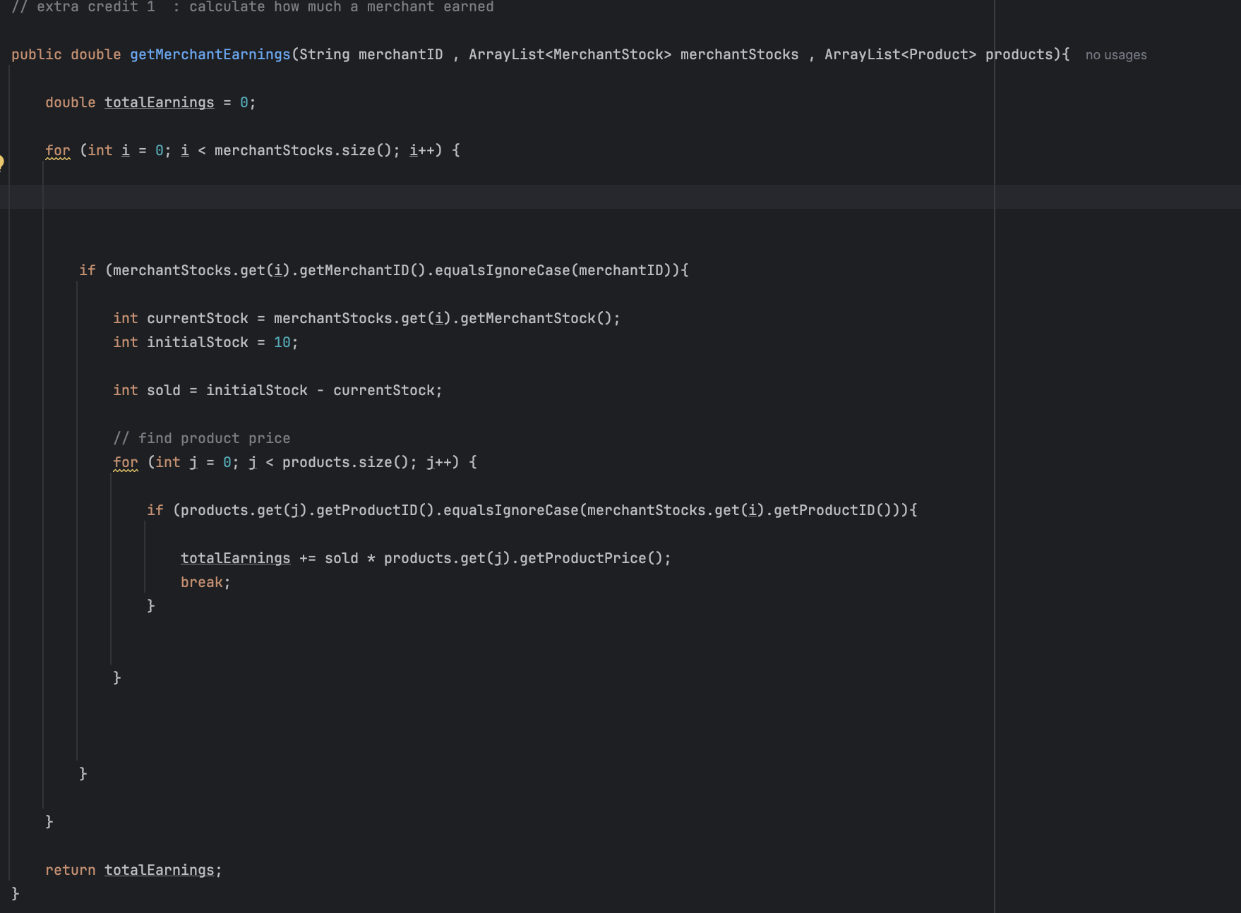
calculate how much a merchant earned

Slide 15
The End
Thank you for listening

